Slide 1
Managing with Big Data “at rest”
Alexander Semenov, PhD

Slide 2
Introduction
Degree in Electrical Engineering, Saint-Petersburg State Electrotechnical University, 2008
PhD thesis “Principles of social media monitoring and analysis software”, defended in May 2013
  Main topic is analysis of social media sites and software for it, supervised by Prof. Jari Veijalainen
Visiting scholar in University at Buffalo, NY, USA; University of Memphis, TN, USA, University of Florida, FL, USA
Currently postdoctoral researcher in CS&IS Dept
  Previous project: computational logistics, spinned of as NFleet
  Current projects: MineSocMed, VISIT, CyberSHOK (security)

Slide 3
Table of contents
Lecture 1
Introduction, Data at rest
Databases, relational databases
  PostgreSQL
NoSQL databases, JSON
ACID vs BASE, CAP theorem
Examples: Redis, MongoDB, CouchDB

Slide 4
Table of contents
Lectures 2 and 3
Parallel programming
MapReduce
Apache Hadoop
  HDFS
  Hbase
  Pig
  Hive
Apache Spark

Slide 5
Data at rest
Data at rest is inactive data which is stored physically in any digital form (e.g. databases, data warehouses, spreadsheets, archives, tapes, off-site backups, mobile devices etc.)
Data at Rest generally refers to data stored in persistent storage (disk, tape) while Data in Use generally refers to data being processed by a computer central processing unit
Data in Use – data being used and processed by CPU
Data in Motion – data that is being moved

Slide 6
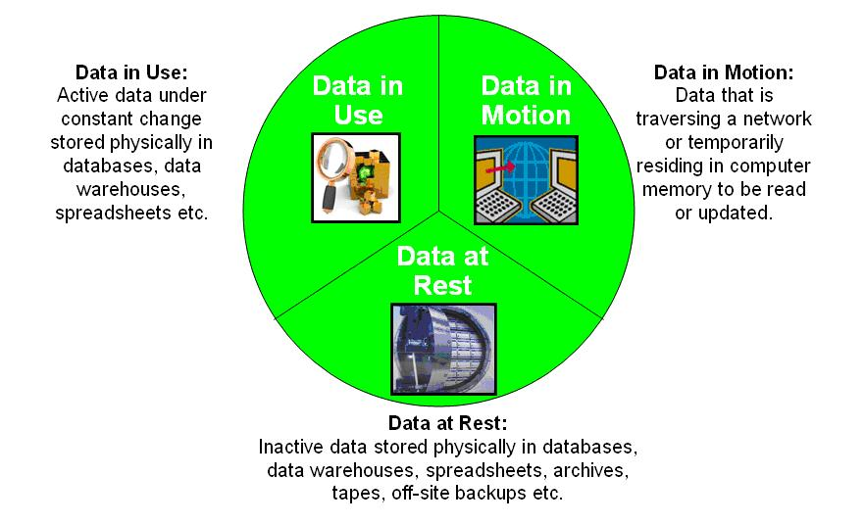
From http://en.wikipedia.org/wiki/Data_at_Rest

Slide 7
Scaling
Recall from previous lecture: from 2013 to 2020, the “digital universe” will grow by a factor of 10 – from 4.4 ZB to 44 ZB. It more than doubles every two years.
  zettabyte equals to 10^21 bytes
For handling these data computing performance and data storages should scale
To scale vertically means to add resources to a single node in a system, typically involving the addition of CPUs or memory to a single computer
To scale horizontally (or scale out) means to add more nodes to a system, such as adding a new computer to a distributed software application.

Slide 8
Scaling
Now, manufacturers of CPUs prefer horizontal scaling
  Multicore CPU
  Multiprocessor CPU
Data are stored in distributed storages
Distributed systems are used to process the data
Distributed computing introduce problems with synchronization

Slide 9
Why do we need databases?
Assume you need to develop a software system for supermarket chain:
  Retrieve every sale in every single store
  Retrieve sales per day
  Retrieve sale per region
  Retrieve sales per product
How do you do it?
  How to find the data
  How to query the data
  How many files you need?
  What happens, if several users modify the data?

Slide 10
Databases
Data may be stored in the databases
A database is an organized collection of data
Database management systems (DBMSs) are computer software applications that interact with the user, other applications, and the database itself to capture and analyze data.

Slide 11
Benefits of the databases
Efficient data access
Data independence
Data integrity
Data administration
Concurrent access and crash recovery
Reduced application development time

Slide 12
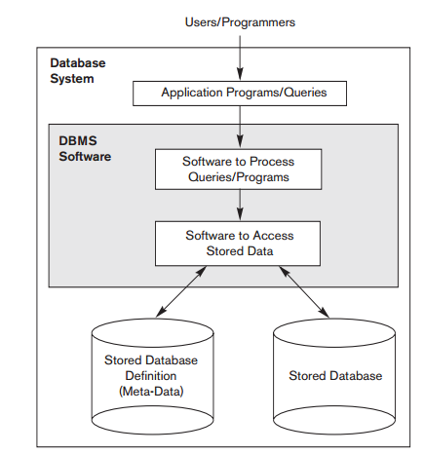
Database architecture
From ”Fundamentals of Database Systems(Elmasri,Navathe), 2010”

Slide 13
Relational databases
A relational database management system (RDBMS) is a database management system (DBMS) that is based on the relational model
The central concept in relational model is the relation: set of rows, represented as a table
RelationName(field1:type1, field2:type2, … ,fieldN:typeN)
The relational database model is based on the concept of two-dimensional tables.
  Proposed by Edgar Frank "Ted" Codd from IBM in 1970.

Slide 14
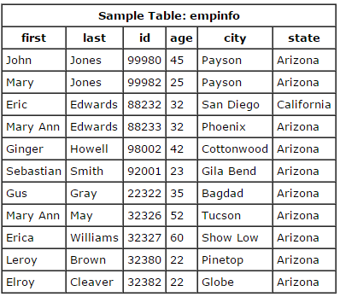
SQL
SQL – standard query language. Language designed for managing data held in RDBMS
select first, last, city
from empinfo;
select last, city, age
from empinfo where
age > 40;
select * from empinfo
where first = 'Eric';
From ”Fundamentals of Database Systems(Elmasri,Navathe), 2010”

Slide 15
SQL
Table can be created
  Create table table_name (a int,b int, c int);
Data can be inserted or updated
  Insert into table_name(a,b,c) values(1,2,10);
Create statement defines table schema; after that, the data should correspond to this schema
  Schema can be edited (“alter table x add column id int”);
  Generally, RDBMS require fixed schema

Slide 16
SQL
Using SQL rows can be selected from the table based on some predicates
  Select * from table_name where a > b and c = 10;
Table elements can be counted
  Select count(*) from table_name;
Multiple tables can be joined
Rows can be grouped

Slide 17
SQL, JOIN
Combines columns from several tables
CROSS JOIN
  Returns Cartesian product of the tables
  SELECT * FROM employee CROSS JOIN department;
  SELECT * FROM employee, department
INNER JOIN
  creates a new result table by combining column values of two (or more) tables
  SELECT * FROM weather INNER JOIN cities ON (weather.city = cities.name);
  Matches only those values, which exist in both tables

Slide 18
SQL, JOIN
create table employee(id serial, name text, dept int);
create table department(id int, name text);
insert into employee(name, dept) values('Alice', 1), ('Bob', 2), ('Alex', 1);
insert into department (name, id) values('Computer Science', 1), ('Operations Research', 2);
select * from employee join department on employee.dept = department.id;

Slide 19

SQL support
There are SQL standards: SQL-86, SQL-89, SQL-92, …, SQL:2008, SQL:2011
  Considered one of the major reasons for the commercial success of relational databases
A number of RDBMS support SQL, some of them add some extensions
  Oracle Database
  Microsoft SQL Server
  MySQL
  IBM DB2
  PostgreSQL
  SQlite
Other tools:
  Apache Hive
  Big SQL

Slide 20
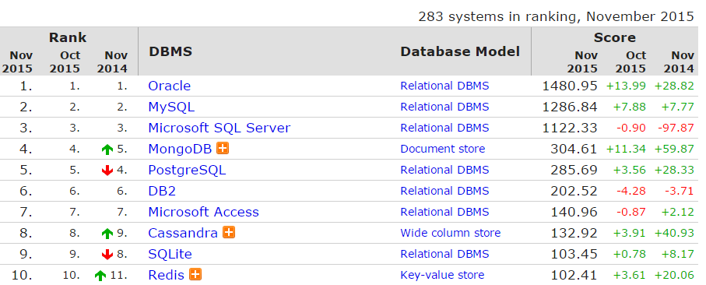
DB rankings
From http://db-engines.com/en/ranking

Slide 21
Example: PostgreSQL
Implements majority of SQL:2011 standard
Free and open source software, can be downloaded from http://postgresql.org
Runs on Linux, FreeBSD, and Microsoft Windows, and Mac OS X
Has interfaces for many programming languages, including C++, Python, PHP, and so on
From 9.2 supports JSON data type
Transactional and ACID compliant
Has many extensions, such as PostGIS (a project which adds support for geographic objects)
Supports basic partitioning
  http://www.postgresql.org/docs/current/static/ddl-partitioning.html

Slide 22
Example: PostgreSQL
Maximum Database Size Unlimited
Maximum Table Size 32 TB
Maximum Row Size 1.6 TB
Maximum Field Size 1 GB
Maximum Rows per Table Unlimited
Maximum Columns per Table 250 – 1600
Maximum Indexes per Table Unlimited
Is this a “Big Data”?

Slide 23
ACID properties
A transaction comprises a unit of work performed within a database management system (or similar system) against a database
Must have ACID properties: Atomicity, Consistency, Isolation, Durability
Atomicity
  Atomicity requires that each transaction be "all or nothing": if one part of the transaction fails, the entire transaction fails, and the database state is left unchanged.

Slide 24
ACID properties
Consistency
  The consistency property ensures that any transaction will bring the database from one valid state to another. Any data written to the database must be valid according to all defined rules
Isolation
  The isolation property ensures that the concurrent execution of transactions result in a system state that would be obtained if transactions were executed serially, i.e. one after the other
Durability
  Durability means that once a transaction has been committed, it will remain so, even in the event of power loss, crashes, or errors.

Slide 25
Summary
SQL offers very powerful querying mechanism
  Advanced algorithms are used for query execution
    cache
Data in RDBMS should be described by fixed schema
RDBMS software is usually very advanced
ACID properties (atomicity, consistency, integrity, durability)
  May add overhead (e.g. while checking consistency, etc)

Slide 26
NoSQL databases
Carlo Strozzi first used the term NoSQL in 1998 as a name for his open source relational database that did not offer a SQL interface
The term was reintroduced in 2009 by Eric Evans in conjunction with an event discussing open source distributed databases
NoSQL stands for “Not Only SQL”

Slide 27
NoSQL databases
Broad class of database management systems that differ from the classic model of the relational database management system (RDBMS) in some significant ways, most important being they do not use SQL as their primary query language
  Do not have fixed schema
  Do not use join operations
  May not have ACID (atomicity, consistency, isolation, durability)
  Scale horizontally
  Are referred to as “Structured storages”

Slide 28
JSON
Very often, data comes in JSON format
JavaScript Object Notation
Popular; there are JSON parsers in many languages, many sites provide JSON interfaces
Types:
  Number
  String
  Boolean
  Null
  Object {} (similar to Python dictionary)
  Array
Many NoSQL databases can import JSON documents directly

Slide 29
JSON
[ 100, 500, 300, 200, 400 ]
{ "firstName": "John", "lastName": "Smith", "age": 25, "address": { "streetAddress": "21 2nd Street", "city": "New York", "state": "NY", "postalCode": 10021 }, "phoneNumbers": [ { "type": "home", "number": "212 555-1234" }, { "type": "fax", "number": "646 555-4567" } ] }

Slide 30
ACID vs BASE
ACID is contrasted with BASE
BASE:
  Basically available
    there will be a response to any request. But, that response could be a ‘failure’ to obtain the requested data or the data may be in an inconsistent or changing state.
  Soft-state
    The state of the system could change over time, so even during times without input there may be changes going on due to ‘eventual consistency’
  Eventual consistency
    The system will eventually become consistent once it stops receiving input. The data will propagate to everywhere it should sooner or later

Slide 31
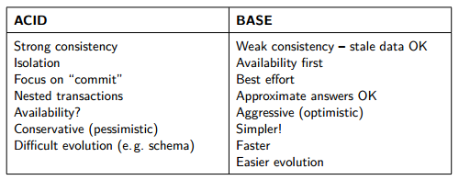
ACID vs BASE
Taken from http://www.christof-strauch.de/nosqldbs.pdf

Slide 32
ACID vs BASE
Strict Consistency
  All read operations must return data from the latest completed write operation, regardless of which replica the operations went to
Eventual Consistency
  Readers will see writes, as time goes on: "In a steady state, the system will eventually return the last written value".

Slide 33
CAP theorem
States that it is impossible for a distributed computer system to simultaneously provide all three of the following guarantees
  Consistency
    A distributed system is typically considered to be consistent if after an update operation of some writer all readers see his updates in some shared data source
  Availability
    a system is designed and implemented in a way that allows it to continue operation
  Partition tolerance
    These occur if two or more “islands” of network nodes arise which (temporarily or permanently) cannot connect to each other; dynamic addition and removal of nodes

Slide 34
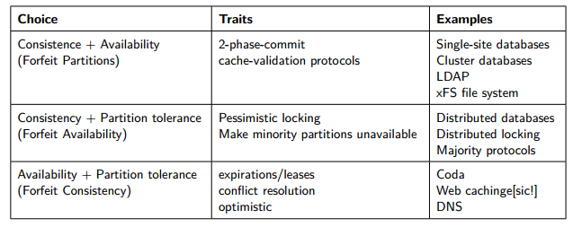
CAP theorem
Taken from http://www.christof-strauch.de/nosqldbs.pdf

Slide 35
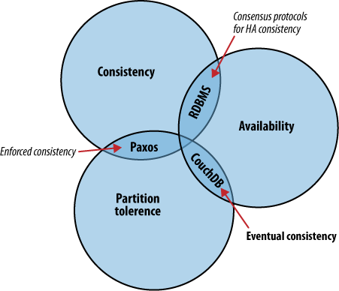
CAP theorem
Taken from http://guide.couchdb.org

Slide 36
NoSQL databases: motives
Avoidance of Unneeded Complexity
  Relational databases provide a variety of features and strict data consistency. But this rich feature set and the ACID properties implemented by RDBMSs might be more than necessary for particular applications and use cases
High Throughput
  Google is able to process 20 petabyte a day stored in Bigtable via it’s MapReduce approach
Taken from http://www.christof-strauch.de/nosqldbs.pdf

Slide 37
NoSQL databases: motives
Horizontal Scalability and Running on Commodity Hardware
  for Web 2.0 companies the scalability aspect is considered crucial for their business
Avoidance of Expensive Object-Relational Mapping
  important for applications with data structures of low complexity that can hardly benefit from the features of a relational database
  when your database structure is very, very simple, SQL may not seem that beneficial
Taken from http://www.christof-strauch.de/nosqldbs.pdf

Slide 38
NoSQL databases: motives
Movements in Programming Languages and Development Frameworks
  Ruby on Rails framework and others try to hide away the usage of a relational database
  NoSQL datastores as well as some databases offered by cloud computing providers completely omit a relational database
Cloud computing needs
Taken from http://www.christof-strauch.de/nosqldbs.pdf

Slide 39
NoSQL databases: criticism
Skepticism on the Business Side
  As most of them are open-source software they are well appreciated by developers who do not have to care about licensing and commercial support issues
NoSQL as a Hype
  Overenthusiasm because of the new technology
NoSQL as Being Nothing New
NoSQL Meant as a Total “No to SQL”

Slide 40
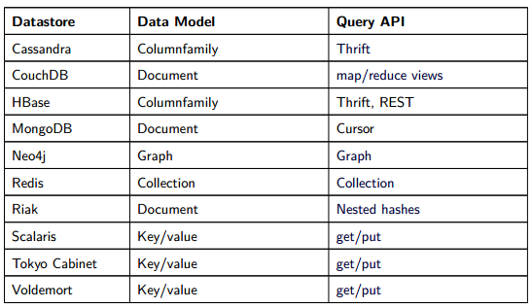
Data and query models
Taken from http://www.christof-strauch.de/nosqldbs.pdf

Slide 41
NewSQL
NewSQL is a class of modern relational database management systems that seek to provide the same scalable performance of NoSQL system, still maintaining the ACID guarantees of a traditional database system
The term was first used by 451 Group analyst Matthew Aslett in a 2011 research paper
One of the most important features is transparent sharding
Examples: dbShards, Scalearc, and ScaleBase

Slide 42
NoSQL example: Redis
REmote DIctionary Server
http://redis.io
http://try.redis.io/ - contains interactive tutorial
Number 1 in db-engines.com key-value stores ranking
Lightweight key-value storage
Stores data in RAM
Supports replication

Slide 43
NoSQL example: Redis
Supports strings, lists, sets, sorted sets, hashes, bitmaps, and hyperloglogs (probabilistic data structure used for approximate count of distinct elements)
  See http://redis.io/topics/data-types-intro
> set mykey somevalue
OK
> get mykey
"somevalue"

Slide 44
NoSQL example: Redis
> set counter 100
OK
> incr counter
(integer) 101
> incr counter
(integer) 102
> incrby counter 50
(integer) 152

Slide 45
NoSQL example: Redis
> set key some-value
OK
> expire key 5
(integer) 1
> get key (immediately)
"some-value"
> get key (after some time)
(nil)

Slide 46
NoSQL example: Redis
> rpush mylist A
(integer) 1
> rpush mylist B
(integer) 2
> lpush mylist first
(integer) 3
> lrange mylist 0 -1
1) "first"
2) "A"
3) "B”
rpop mylist
B

Slide 47
NoSQL example: Redis
> hmset user:1000 username antirez birthyear 1977 verified 1
OK
> hget user:1000 username
"antirez"
> hget user:1000 birthyear
"1977"
> hgetall user:1000
1) "username"
2) "antirez"
3) "birthyear"
4) "1977"
5) "verified"
6) "1"

Slide 48
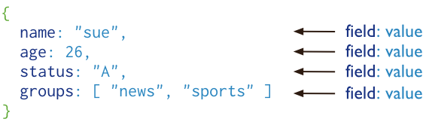
MongoDB
cross-platform document-oriented database
  Stores “documents”, data structures composed of field and value pairs
  Key features: high performance, high availability, automatic scaling, supports server-side JavaScript execution
Has interfaces for many programming languages
From http://www.mongodb.org/

Slide 49
MongoDB
> use mongotest
switched to db mongotest
>
> j = { name : "mongo" }
{ "name" : "mongo" }
> j
{ "name" : "mongo" }
> db.testData.insert( j )
WriteResult({ "nInserted" : 1 })
>
> db.testData.find();
{ "_id" : ObjectId("546d16f014c7cc427d660a7a"), "name" : "mongo" }
>
>
> k = { x : 3 }
{ "x" : 3 }
> show collections
system.indexes
testData
> db.testData.findOne()

Slide 50
MongoDB
> db.testData.find( { x : 18 } )
> db.testData.find( { x : 3 } )
> db.testData.find( { x : 3 } )
> db.testData.find( )
{ "_id" : ObjectId("546d16f014c7cc427d660a7a"), "name" : "mongo" }
>
> db.testData.insert( k )
WriteResult({ "nInserted" : 1 })
> db.testData.find( { x : 3 } )
{ "_id" : ObjectId("546d174714c7cc427d660a7b"), "x" : 3 }
>
> var c = db.testData.find( { x : 3 } )
> c
{ "_id" : ObjectId("546d174714c7cc427d660a7b"), "x" : 3 }

Slide 51
MongoDB
db.testData.find().limit(3)
db.testData.find( { x : {$gt:2} } )
> for(var i = 0; i < 100; i++){db.testData.insert({"x":i});}
WriteResult({ "nInserted" : 1 })
> db.testData.find( { x : {$gt:2} } )
{ "_id" : ObjectId("546d174714c7cc427d660a7b"), "x" : 3 }
{ "_id" : ObjectId("546d191514c7cc427d660a7f"), "x" : 3 }
{ "_id" : ObjectId("546d191514c7cc427d660a80"), "x" : 4 }
{ "_id" : ObjectId("546d191514c7cc427d660a81"), "x" : 5 }
{ "_id" : ObjectId("546d191514c7cc427d660a82"), "x" : 6 }
> db.testData.ensureIndex( { x: 1 } )

